Slide 1
MAR 580: Advanced Population Modeling for Management of Living Marine Resources
Lecture 1
Introduction
www.mycourses.umassd.edu
1 September 2015

Slide 2
Today’s Outline
Introductions
Course Mechanics, etc.
Introduction to programming, why ADMB?
Lab exercise: Linear modeling using ADMB

Slide 3
Instructor contact information
Gavin Fay
gfay@umassd.edu
508-910-6363
SMAST II Rm 325B
@gavin_fay
Office hours: by appointment
Steve Cadrin
scadrin@umassd.edu
508-910-6358
SMAST II Rm 325
Office hours: Tuesday afternoons or by appointment

Slide 4
Course participants
Who, why, when, what, where:
Degree status
Program
Research interests
Background and experience
Why are you taking this class?

Slide 5
Course materials
MAR580 course website on myCourses
Syllabus
Lecture materials
Readings
Lab / assignment files
Assignment submission
Is anyone NOT receiving info from myCourses?

Slide 6
Course Readings
Weekly papers / book chapters.
There are no texts that fully cover the range of topics and material in this class.
Electronic copies (pdfs) of papers and book chapters distributed through course website.
Additional recommended readings also provided each week for further interest…

Slide 7
Course Mechanics: Format
Each week:
1. Informal lecture
2. Break
3. Computer lab
Some probable degree of overlap between lecture/lab material.

Slide 8
Course Mechanics: Evaluation
Semi-weekly Lab exercise assignments (80%)
Class Project (20%)
University Academic Integrity policy applies: http://www.umassd.edu/studentaffairs/studenthandbook/academicregulationsandprocedures/

Slide 9
Weekly assignments (80%)
Weekly lab exercise. Some of these will be longer requiring additional work, all should be submitted as assignments.
Assignments are due prior to class.
10/100 deducted for each day late.

Slide 10
Projects (20%)
Apply one or more methods from class to research topic.
Written Report (~10 pages) in form of scientific paper (Intro, Methods, Results, Dicussion, Figures/Tables).
Due Dec XX.
Oral presentation of project (Date TBD, Final Exam slot?).
Descriptions of project topics due September XX.
1-2 page project outline due October XX.
Projects that help you make progress on thesis chapters heavily encouraged.

Slide 11
Participation, attendance, ethics (40%)
Find and distribute an article each week
(can be article used in weekly assignment)
Participate in Discussions of Readings
Sign-up for papers online
Lead at least one weekly class discussion
Post responses to blog posts in at least two weeks

Slide 12
Literature
List of background readings on syllabus and myCourses.
Pdf’s of weekly readings on myCourses.
Sign up for which ones to lead in discussion, report upon.
Find new pieces of EBFM literature, distribute each week.

Slide 13
Tips for Critically Reading Literature
What are the main points of the paper?
What type of document is it?
Who wrote it, who do they work for, what is their reputation, who funded it, etc.?
Why was the work written? Is the objective clearly stated?
Does the evidence support the conclusions?
Is the logic reasonable and easy to follow?

Slide 14
Tips for Critically Reading Literature
Are there any novel methods worth considering?
Are there any novel concepts worth considering?
Is there anything in it that you can use for your own work (rates, concepts, estimates, etc.)?
As you read it, how would you describe this work to:
Your parents
A high school class
A congressional delegation
Your scientific peers

Slide 15
Course objectives
Understanding of major issues facing global fisheries, fisheries science, and fisheries management.
Familiarity with the theory, history, background, and socio-economic issues driving EBFM.
Develop knowledge of major modeling and technical approaches for implementing EBFM.
Develop skills for critically evaluating current literature and contextualizing it and associated theory with real world case studies.

Slide 16
One main theme throughout course….
CONFRONTING TRADEOFFS

Slide 17
Simplified Schedule
Week | Theme | Topic
1/30 | Context | Introduction, What is EBFM?
2/6 |  | Challenges facing fisheries, what can EBFM offer?
2/13 |  | Guest lecture: case studies of EBFM
2/20 |  | When to consider doing EBFM?
2/27 |  | Types of advice, decision theories, goal-setting
3/6 | Operational | Ecosystem indicators
3/13 |  | Extended single-species and multispecies models
3/20 |  | SPRING BREAK
3/27 |  | Aggregate and system models
4/3 |  | Ecological risk assessment
4/10 | Institutional | Societal and economic considerations
4/17 |  | Governance and management institutions
4/24 | Holistic | Evaluating tradeoffs
5/1 |  | Moving towards ecosystem based management
5/13 |  | Final exam: Project Presentations

Slide 18
What is a fishery?
The complex of people, their institutions, their harvest and their observations associated with and including a targeted stock or group of stocks (i.e., usually fish)

Slide 19
Fishery
Management
Economic
Considerations
Social
Considerations
Conservation
Requirements

Slide 20
Limnology &
Oceanography
Population
Biology
Resource
Economics
Fishery
Science
Social
Sciences
Stock
Assessment
Ecosystem
Dynamics

Slide 21
Why is “ecosystem management” an issue?
Competing stake-holders and legislation
Debate over the importance of different processes (fishing, environment, predation, etc.)
Limitations of single species management
Used as a scapegoat for lack of action
Adversarial science- scientists as advocates

Slide 22
What is Ecosystem Based Fisheries Management?

Slide 23
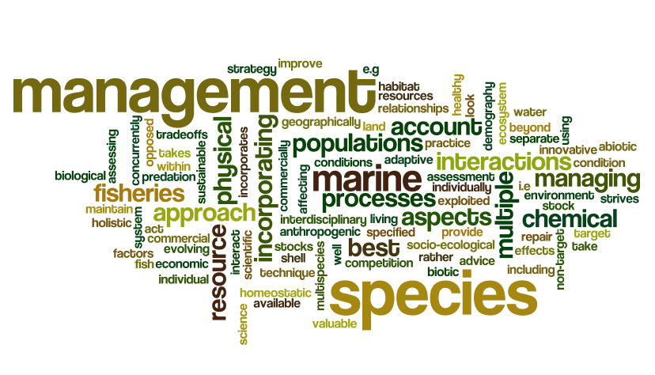
What is Ecosystem Based Fisheries Management?

Slide 24
What is EBFM?
“Managing fisheries to coordinate, account for, and include all factors in a holistic, synthetic, integrated fashion. Fisheries are emphasized, but the inclusion of marine mammals, protected species, non-target species, etc., are explicitly included.”
“Ultimately what EAF/EBFM means is that we are trying to manage fisheries in a broader ecosystem context, ….”
(Link 2010)

Slide 25
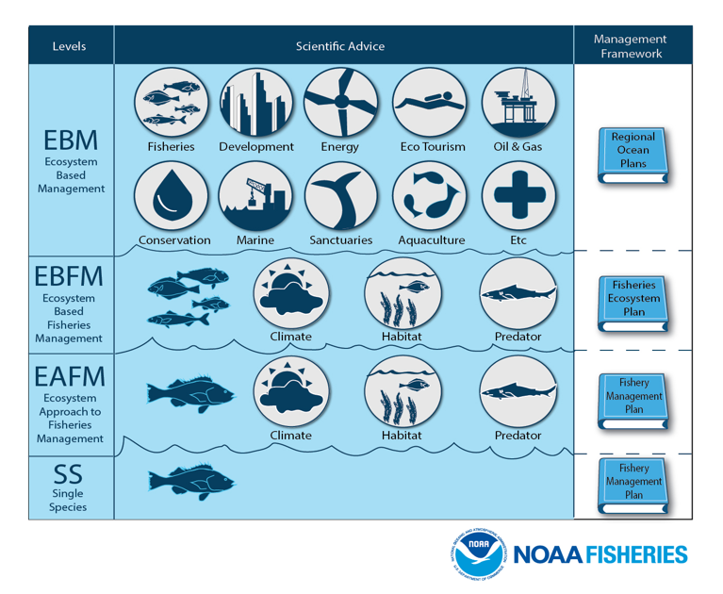

Slide 26
What does an Ecosystem Approach provide that we can’t get from single-species?
Address effects of fishing on:
non-target species
habitat,
ecological interactions, and
system-wide processes
Recognizes that marine ecosystems provide “goods & services” other than fishery harvest
Explicitly addresses biomass tradeoffs
Increases leverage from new stakeholders
Changes the burden of proof

Slide 27
What is the issue?
Is Fishing impacting other Ecosystem Components & Properties?
Impacts to other Fishing Sectors
Impacts Across broader Ocean-use sectors
Impacts to other, legally considered spp.
Are other Ecosystem Considerations impacting the fishery (i.e. fish stocks)?

Slide 28
What is EBFM?
Questions?

Slide 29
What’s next
Fisheries Science Review
Challenges Facing Fisheries
What does EBFM have to offer?
Discussion on:
Caddy 1999
Guerry 2005
Browman & Stergiou 2004

